Slide 1
Efficient Reinforcement Learning with Initialized Policy
May 8th, 2019
Individual Study Option
Zihan Ding
Supervisor: Dr. Edward Johns

Slide 2

Reinforcement Learning
Figure source: Sutton & Barto, 1998
Notes:
reinforcement learning is an agent interact with the enrironment, and the aget makes action choice based on current state, the environment have a corresponding change in the states according to the action, and give a reward as feedback.

Slide 3
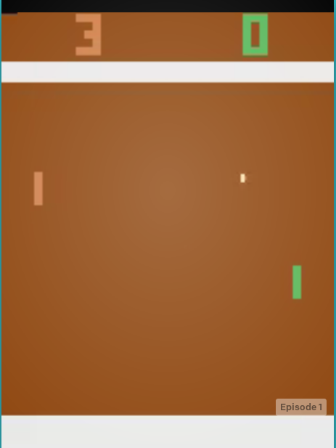
Problems of Reinforcement Learning
Unstable training process: different random seeds may cause very different results;
Hard hyper-parameters tuning: especially when applying deep reinforcement learning;
Poor sample efficiency: take Pong game as an example, human only needs seconds to learn, while RL agent needs tens of thousands of examples to learn a same-level performance, leading to low learning efficiency and long training time;
etc.

Slide 4
Approaches of Improving Learning Efficiency
From RL algorithms:
improve algorithms design, like sample efficiency, stability, high-order optimization, etc.
From leveraging extra information: ( initialization policy)
leverage expert demonstraions;
meta-learning, transfer learning without demonstrations;
etc.

Slide 5
Why initialization matters?
A policy is represented as a set of parameter values in deep reinforcement learning. The information and knowledge about controlling the agent in the environment are all stored in weights of neural networks. A proper initialization of the policy will enable the RL agent to learn based on some hidden knowledge or principles (e.g. dynamics of the environment, preferences for action choices, etc), which could significantly improve the learning efficiency in practice.
The approach of leveraging expert demonstraions as initialization is like someone teaching you how to achieve a task;
The approach of meta-learning as initialization is like learning with a basic understanding about the dynamics.

Slide 6
Outlines:
Reinforcement Learning Algorithms
Environment (Reacher)
Efficient Reinforcement Learning with Demonstrations
Approaches of generating demonstrations
Approaches of leveraging demonstrations as initialization
Comparisons of three different methods in experiments:
(1). Behavioural Cloning; (2). Residual Policy Learning; (3). Feeding Demonstrations into Memory Buffer (DDPGfD).
Efficient Reinforcement Learning without Demonstrations
Meta-learning as initialization for RL
Comparison of two methods in experiments:
(1). Reptile; (2). FOMAML.
Universal Successor Representation.
Summary
Notes:
3-4min

Slide 7
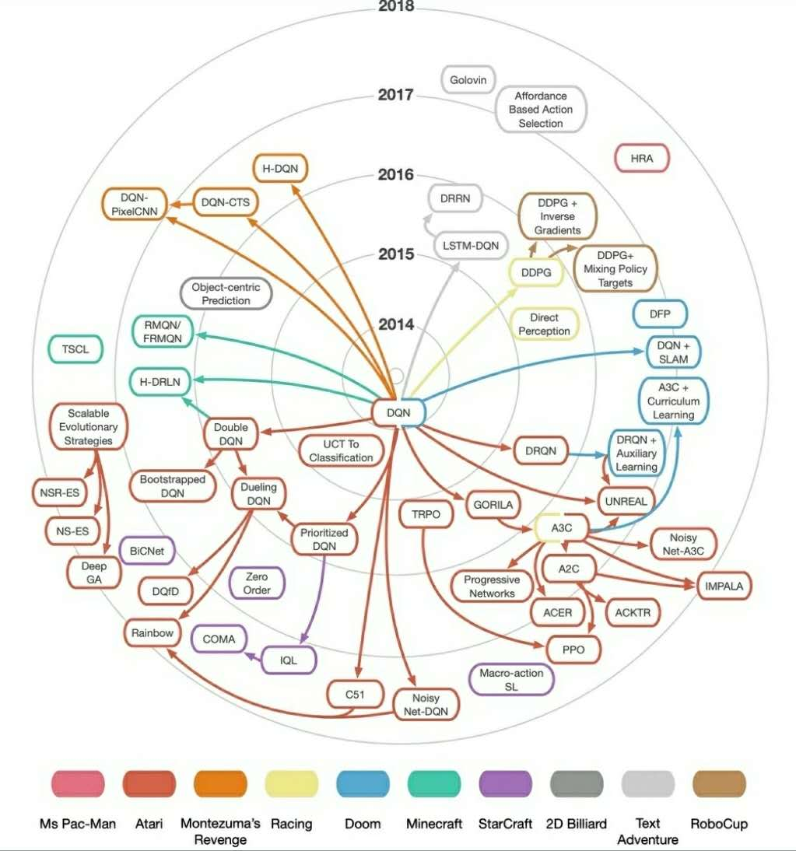
Reinforcement Learning Algorithms
Figure source: Twitter

Slide 8
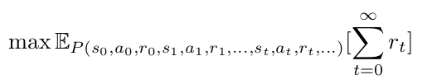
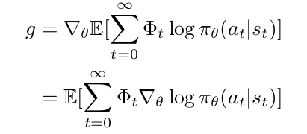
Basics of RL
The Goal of RL:
With the assumptions of Markov process and deterministic transformantion process, the gradient-based optimization is:
Notes:
where phi t could be reward, value, or advantage functions for different kinds of estimation.
derivative of expected probable reward over parameter theta for trajectories that the policy choose to follow

Slide 9
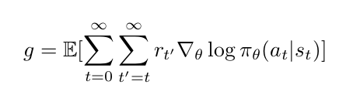
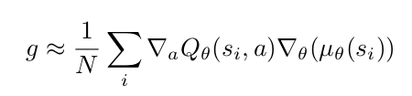
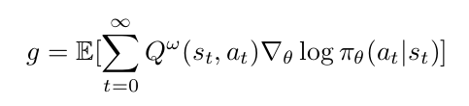
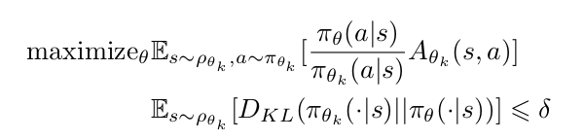
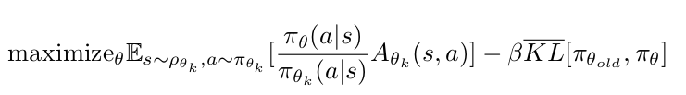



Key functions in Present RL Algorithms
REINFORCE (Vanilla Policy Gradient):
Deep Deterministic Policy Gradient (DDPG):
Actor-Critic:
Trust Region Policy Optimization (TRPO):
Q-learning:
Proximal Policy Optimization (PPO):
Deep Q-Network (DQN):
or:
still in progress......
Notes:
reinforce, actor-critic are similar to the form I just mentioned above
q-learning is a tabular based method
dqn applies deep nn for evaluate q value
ddpg is combination of DQN and policy gradient
trust region based method trpo and ppo,
I use ddpg and ppo in experiments

Slide 10


Present RL Algorithms
Deep Deterministic Policy Gradient (DDPG):
DDPG is a off-policy RL algorithm extended from DQN for continuous action space. It learns to estimate the Q-value function according to the Bellman Optimal Equation:
The loss function of Q-value estimation is defined with a mean-squared-error (MSE):
The policy is trained via policy gradient:
Tricks like replay buffers and target networks from DQN are applied in DDPG.

Slide 11
Present RL Algorithms
Proximal Policy Optimization (PPO):
PPO is an on-policy RL algorithm based on trust-region method TRPO, and it applies several tricks to make second-order optimization in TRPO to be first-order optimization in PPO. The main contribution of TRPO is to apply a surrogate objective for a constrained optimization problem, to ensure the stable improvement of learning:
One version of PPO called PPO-Clip applies a clip in the surrogate objective in TRPO to remove the constraint in optimization:
Another version of PPO called PPO-Penalty applies a soft penalty instead of the hard constraint in the constrained optimization of TRPO:
Generally PPO works simpler and faster with a performance at least as well as TRPO.

Slide 12
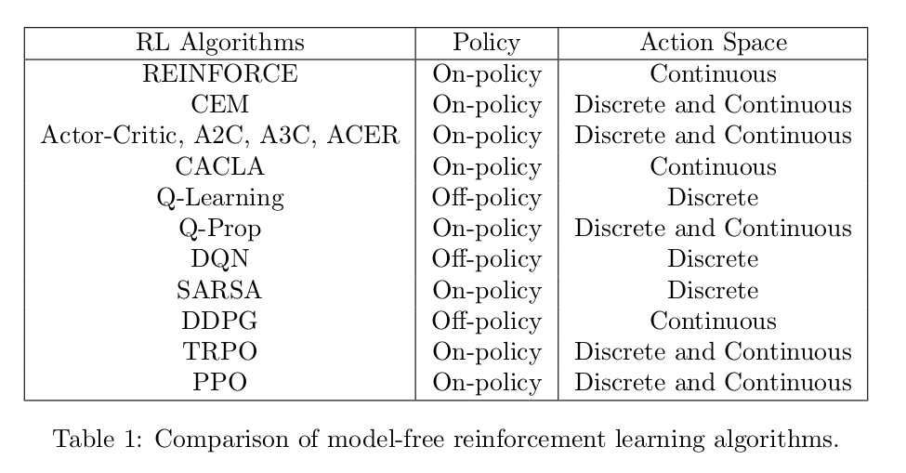
Notes:
cem: policy iteration like q-learning, but use cross-entropy for updating the policy
cacla: continuous actor-critic learining automation, continuous case of actor-critic
q prop: on policy stochastic actor like trpo, but off policy critic like ddpg

Slide 13
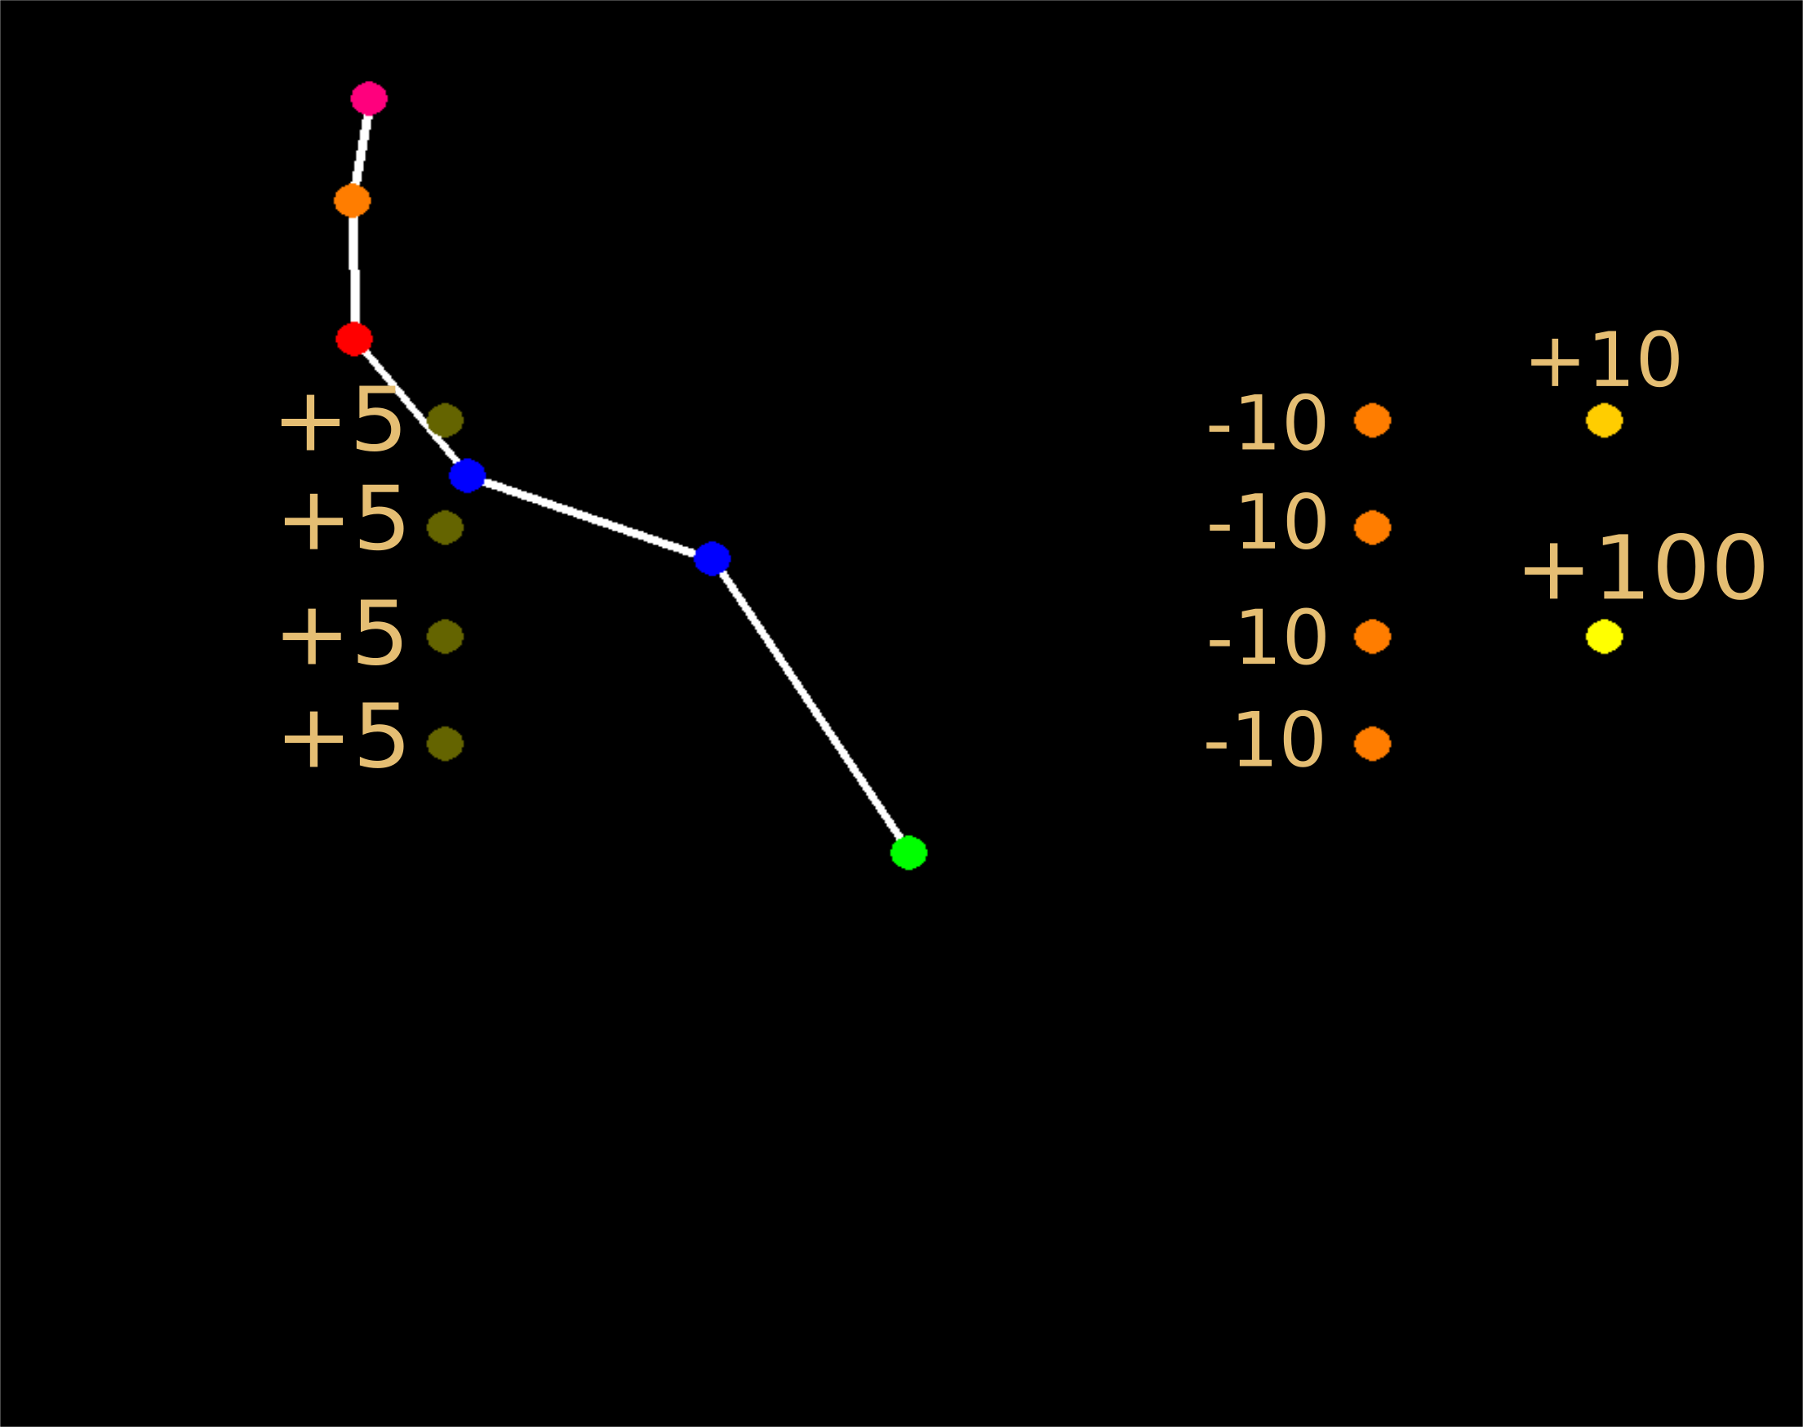
Environment
Reacher:
Notes:
those points with numbers beside are target or penalty positions
the reacher will get the score of those numbers when its end reach to those points

Slide 14
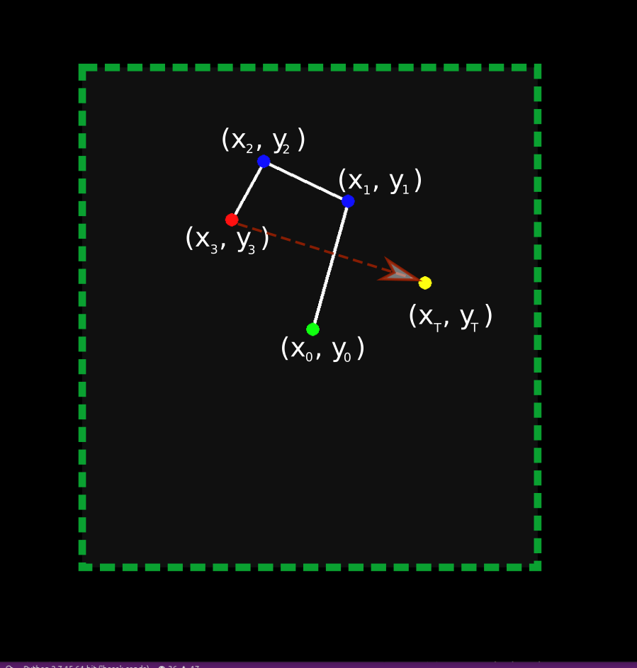
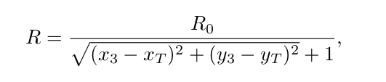
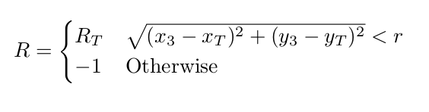
Environment
Reward Function
(for single-goal and three-joint Reacher)
Dense Reward:
Sparse Reward:
Notes:
10min
r0 is the maximal reward

Slide 15

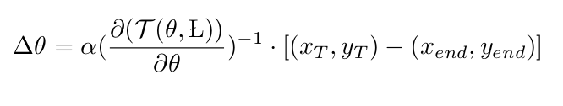
Efficient Reinforcement Learning
with Demonstrations
Approaches of generating demonstrations:
Model-based reinforcement learning: (not accurate, only in simulation)
The learned policy with model-based RL method like model predictive control (MPC) can be used to initialize a model-free reinforcement learning model with supervised imitation learning.
Analytic-form solutions like inverse kinematics: (cheap and accurate, only in simulation)
Human expert demonstrations. (expensive, in both simulation and reality)
Notes:
mpc: gather example trajectories with the MPC controller, which uses the learned dynamics that was trained using our model-based reinforcement learning algorithm

Slide 16
Efficient Reinforcement Learning
with Demonstrations
Approaches of leveraging demonstrations: (Imitation Learning)
Supervised learning approach:
Behavioural Cloning, Residual Policy Learning, DAGGER, Variational Dropout, Dynamic Movement Primative, One-shot Imitation Learning with Soft Attention, etc.
Inverse reinforcement learning approach:
To extract a reward function from observed optimal behavior, like the expert demonstrations, or say to find a loss function under which the observed trajectories is optimal.
Generative adversarial approach:
The generative adversarial imitation learning (GAIL) applies a discriminator in generative adversarial networks (GAN) for providing the estimation of action-value function based on demonstrations.
Other approaches:
Feeding Demonstrations into Memory Buffer (DDPGfD), .Deep Q-Learning from Demonstrations, Normalized Actor-Critic, Reward Shaping, Optimistic Initialization, etc.
Notes:
dmp: analytic form solution for generalizing the demonstrations
dqfd: combine the supervised learning loss and the rl loss, train at the same time
nac: same form objective for supervised loss and rl loss, train in sequence (first supervised, then rl)
reward shaping: focus on value function instead of the action policy
optimistic initialization: shape reward function with some sampled trajectories (or demonstrations) for boosting exploration

Slide 17
Efficient Reinforcement Learning
with Demonstrations
Policy trained with demonstrations as initialization: as the reinforcement signals can still be provided after the imitation learning process with demonstrations, the RL learning can thus take the policy learned from imitation learning as an initialization.
Therefore, we do not require the policy from imitation learning to be optimal, but good enough with a relatively simple imitation learning process, like the following methods:
Behavioural Cloning;
Residual Policy Learning;
Feeding Demonstrations into Memory Buffer (DDPGfD).
Notes:
instead of using the policy trained with demonstrations as final policy, we use it as intialization policy, as rl signals can still be provided in our tasks

Slide 18
Efficient Reinforcement Learning
with Demonstrations
Behavioural Cloning;
Residual Policy Learning;
Feeding Demonstrations into Memory Buffer (DDPGfD);
Comparisons.

Slide 19

Efficient Reinforcement Learning
with Demonstrations
Behavioural Cloning as Initialization:
Simply train a policy with demonstrations in a supervised manner, and use it as an initialization policy for RL.
Lessons in Practice:
(1). Different initial policy requires different noise scales to achieve better performances. For expert initialization policy, smaller exploration noise for DDPG shows better learning effects; for half-expert initialization policy, larger noise shows better learning effects.
(2). The preheating process is important for initialized policy on DDPG: with the pre-training of the critic before general learning process of DDPG, the learning performance is always better than without it. It reduces the dramatic decrease at the initial training phase when the DDPG is initialized with an expert policy. The important intuition from this is that we should not use the critic for instructing the actor unless it’s good enough for a good actor.
Notes:
ddpg contains an actor and a critic, we only replace the actor using behaviour cloning as initialization, but leave the critic. so critic is relatively bad compared with the actor.

Slide 20
Efficient Reinforcement Learning
with Demonstrations
Behavioural Cloning;
Residual Policy Learning;
Feeding Demonstrations into Memory Buffer (DDPGfD);
Comparisons.

Slide 21

Efficient Reinforcement Learning
with Demonstrations
Residual Policy Learning:
The action is determined by the sum of an initialization policy, which is pre-trained and fixed, and a residual policy, which is initialized zero and going to be trained in the RL process.

Slide 22
Efficient Reinforcement Learning
with Demonstrations
Behavioural Cloning;
Residual Policy Learning;
Feeding Demonstrations into Memory Buffer (DDPGfD);
Comparisons.

Slide 23
Efficient Reinforcement Learning
with Demonstrations
Feeding Demonstrations into Memory Buffer (DDPGfD):
Directly feeding demonstrations into the memory buffer, and sampling from both demonstrations and explored trajectories for training the RL agent.
Factors that could matter:
The ratio of the number of demonstration samples over all samples in the memory buffer controls the extent of leveraging demonstration in the RL process. A proper range of ratio is needed to guarantee more improvement in RL process. In the original paper they use prioritized experience replay to naturally balance it.

Slide 24
Efficient Reinforcement Learning
with Demonstrations
Behavioural Cloning;
Residual Policy Learning;
Feeding Demonstrations into Memory Buffer (DDPGfD);
Comparisons.

Slide 25
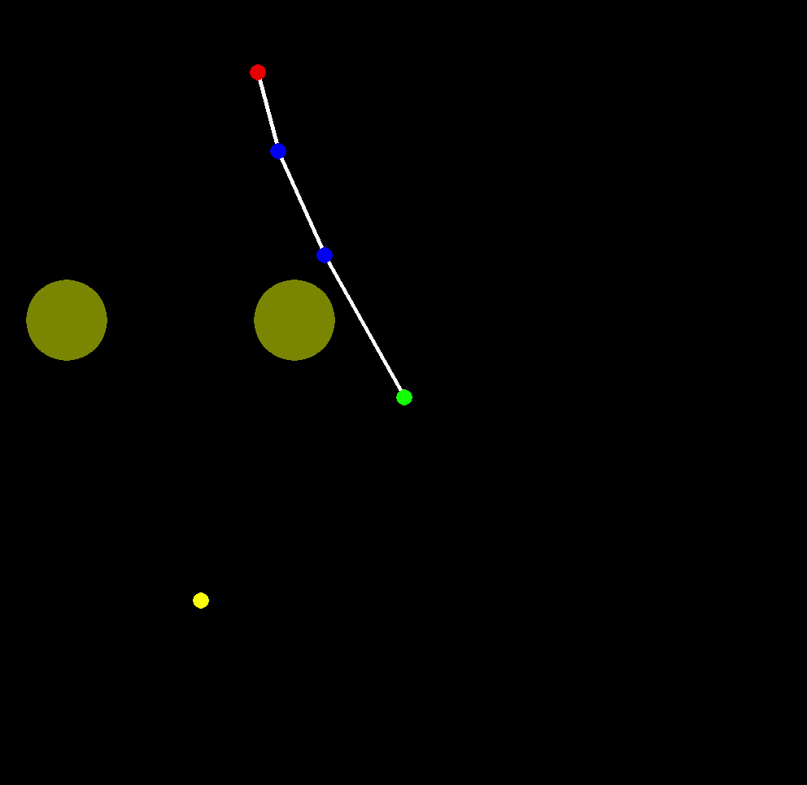
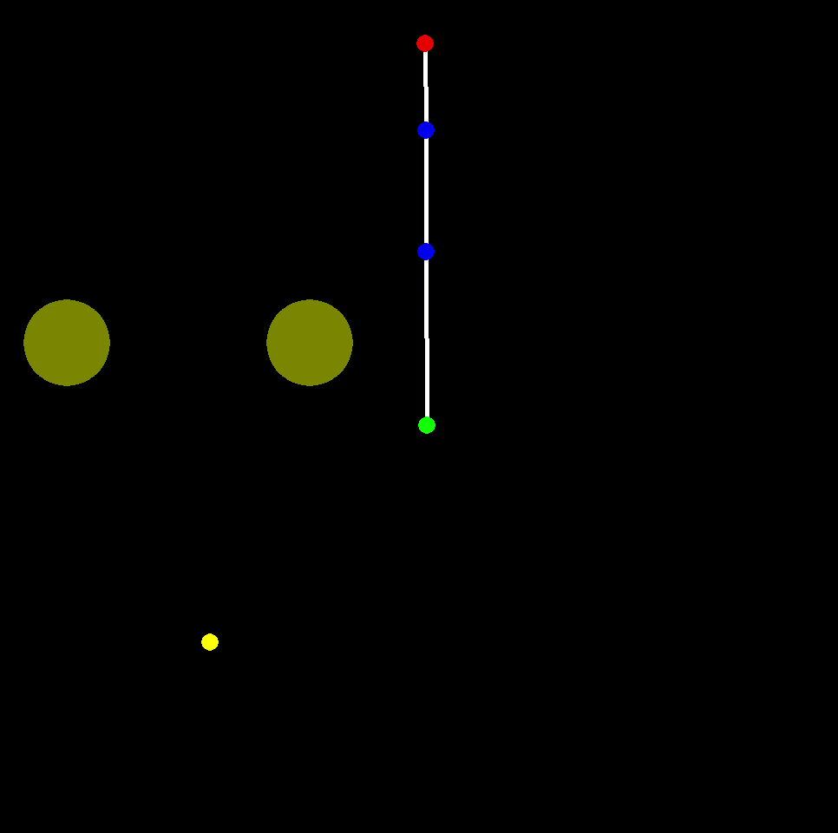
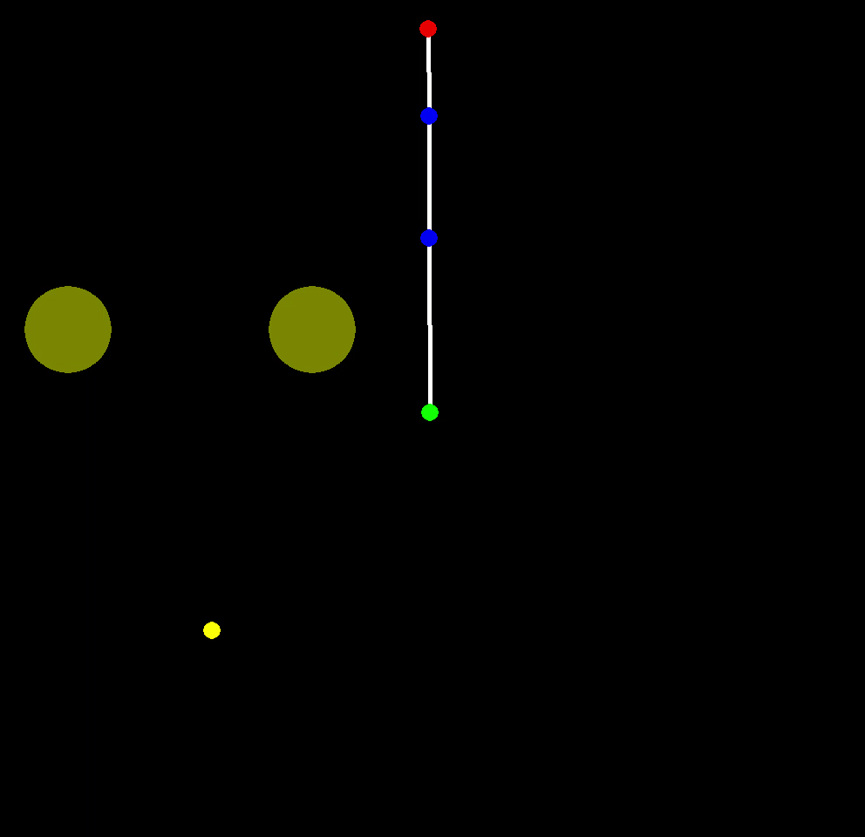
Efficient Reinforcement Learning
with Demonstrations
Random Initialization
Initialization Policy
(a relatively good one)
Final Learned Policy
(near optimal)
Notes:
all methods based on DDPG are able to reach a final performance near optimal like the right one, just the difference in learning time.
so I will focus on showing their differences in learning efficiency

Slide 26
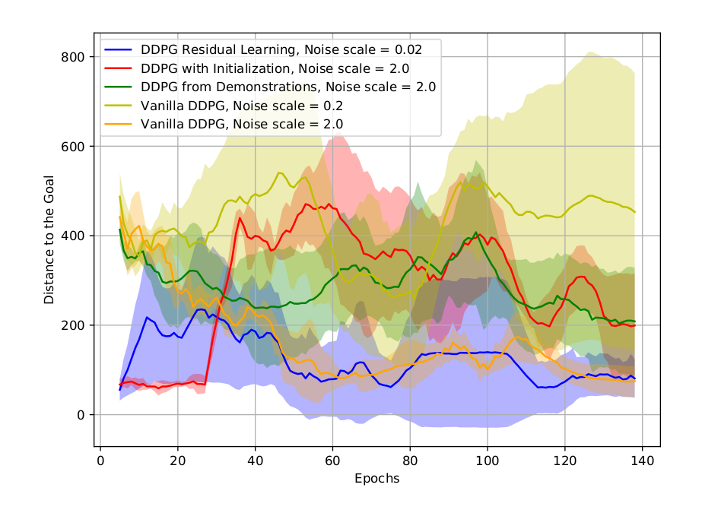
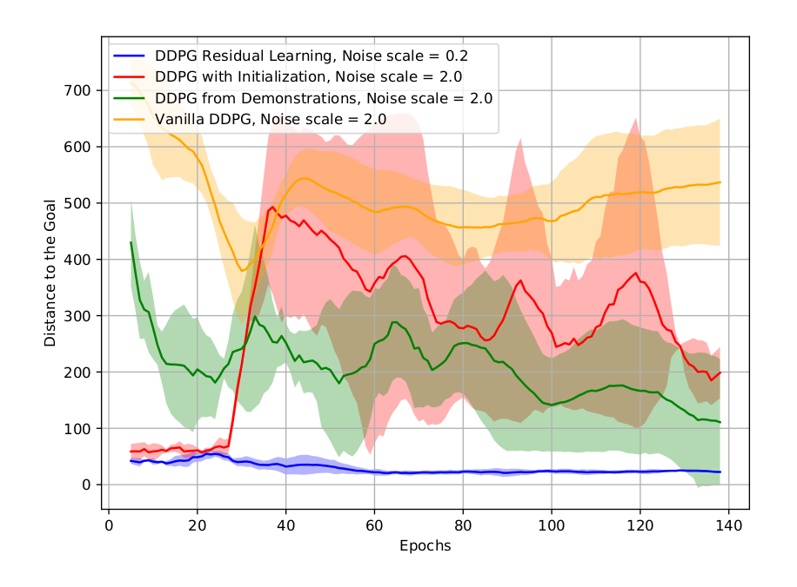
Efficient Reinforcement Learning
with Demonstrations
Comparisons of different methods on Reacher task: Behavioural Cloning, Residual Policy Learning, Feeding Demonstrations into Memory Buffer (DDPGfD).
Dense Reward
Sparse Reward
Notes:
the y axis is the distance to the goal, x axis is the training epochs
vanilla ddpg could work for the case with dense reward, but cannot learn even anything useful for a sparse reward case
the residual policy learning works quite well for both cases,
other methods could be effective in the case of sparse reward

Slide 27
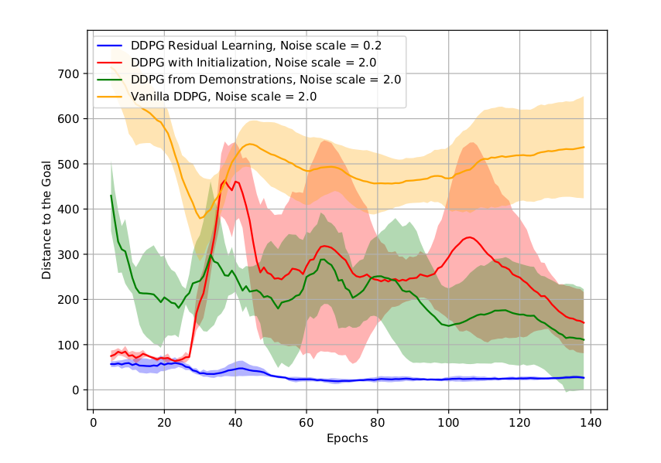
Efficient Reinforcement Learning
with Demonstrations
Comparisons of different methods on Reacher task: Behavioural Cloning, Residual Policy Learning, Feeding Demonstrations into Memory Buffer (DDPGfD).
Large Demonstration Dataset (1000)
Small Demonstration Dataset (50)

Slide 28
Efficient Reinforcement Learning
with Demonstrations
Conclusions from experiments:
1. The approach of learning with demonstrations fed directly into the memory buffer shows robust improvement in learning performance with general experiment settings;
2. The approach of residual policy learning works the best with fine-tuning and good initialization policy, benefiting from the restricted exploration range (sometimes manually set according to the performance of initialization policy) of the residual policy;
3. Vanilla DDPG could work well with dense reward function, but much worse with sparse reward function, even learn nothing useful in the early training stage;
4. The effect of improvement in learning performance using above methods for leveraging demonstrations, including policy replacement, residual policy learning and directly feeding demonstrations into memory, is more prominent with sparse reward function than with dense reward.
5. There is no prominent bad effects when the demonstration dataset for training the initialization policy using supervised imitation learning is small, for the case of sparse reward function. And the case of dense reward function is supposed to be similar. But of course, if the demonstration dataset is too large (if covering most cases of the action space, it could be directly used as the policy without RL) or too small (e.g. 1 or 2 demonstrations), it could make some differences.
Notes:
18min

Slide 29
Efficient Reinforcement Learning
without Demonstrations
Instead of leveraging extra information from demonstrations, efficient RL without demonstrations could improve the learning process through transferring the common knowldedge from other tasks within the same task domain, which is called the meta-learning.
Meta-learning can also work as an approach of intialization policy for both supervised learning and reinforcement learning.

Slide 30




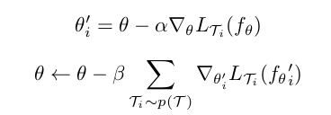


Efficient Reinforcement Learning
without Demonstrations
Some present meta-learning algorithms:
Model-Agnostic Meta-Learning (MAML):
Mulit-Model Model-Agnostic Meta-Learning:
First Order Model-Agnostic Meta-Learning (FOMAML):
E-MAML:
Negative Adaptation in MAML:
Reptile:
Still in process...
Notes:
mumomal has an extra part to be aware of different tasks, extra model-based meta-learner on top of gradient-based meta-learner in maml
e-maml is adding another term in the loss function, which makes a stochastic gradient update of inner policy instead of deterministic in conventional maml
negative adaptation in maml found some problems in maml that the inner updated policy may be worse than the initial policy, and make a proposal about how to modify it

Slide 31
Meta-Learning Algorithms
First Order Model-Agnostic Meta-Learning (FOMAML):
MAML is a meta-learning algorithm for more efficient learning across tasks. It applies an inner-loop udpate for each sampled task and an outer-loop general update for the meta-parameters to keep track of each inner-loop update:
FOMAML is a first-order version of MAML, which stops tracking the gradients in inner-loop update during the outer-loop update:
The loss function in both MAML and FOMAML could be general RL policy loss, like the loss function defined in PPO.

Slide 32
Meta-Learning Algorithms
Reptile:
Reptile is another first-order meta-learning algorithm similar to FOMAML. It simply updates the meta-parameters according to each inner-loop update:
Reptile is surprisingly simple with lower computation cost, and it could work fairly well in for learning to learn in practice.

Slide 33
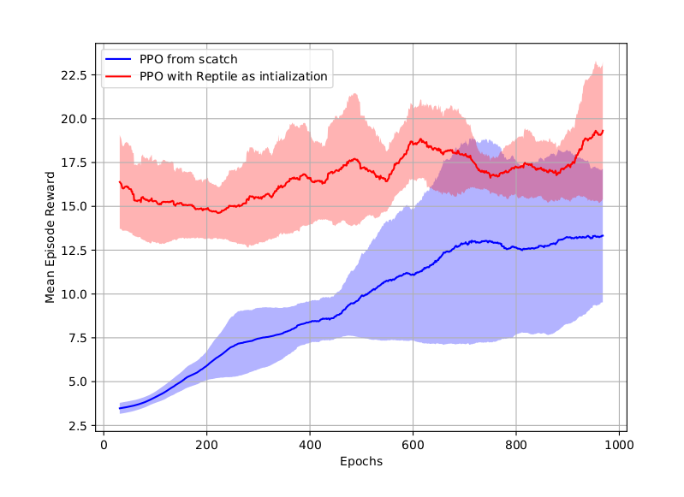
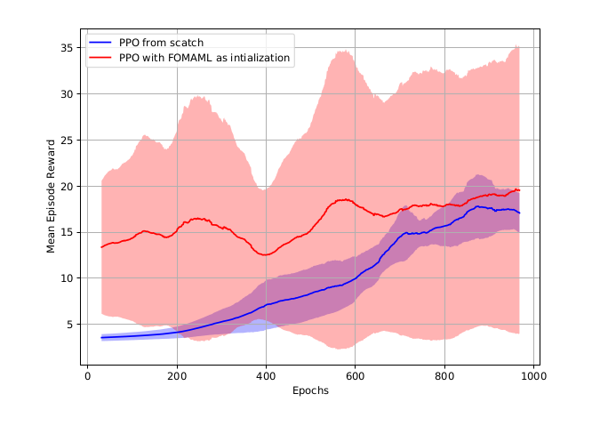
Efficient Reinforcement Learning
without Demonstrations
Comparisons of different methods on Reacher task: Reptile and FOMAML. (with PPO as RL algorithm)
Reptile
FOMAML
Notes:
meta-learning as initialization can make robust improvement based on initialization
y axis if final reward, the larger the better

Slide 34
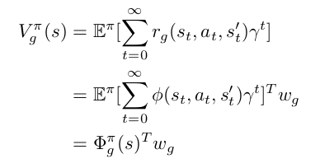
Efficient Reinforcement Learning
without Demonstrations
Universal Successor Representation
Universal Successor Representation (USR) provides a way to learn a universal value function approximator. The value function for each specific can be factorized as a matrix product of a universal value function and task-specific weight parameters.
USR can therefore work as a learner across tasks and initialization for specific task within the task domain.
Notes:
coordinatively update two parts

Slide 35
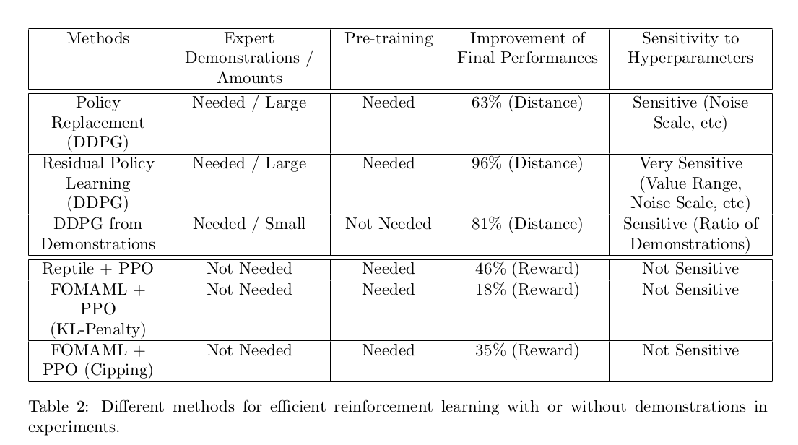
A Summary of Different Methods in Efficient Reinforcement Learning with/without Demonstrations
Notes:
the top 3 methods are ..., measured in improvement in final distance to the goal
the 3 methods in the bottom ..., measured in improvement of reward
the final column also shows how sensitive those methods could be to different hyperparameters

Slide 36
Questions?

